Slide 1
The Signature-based Model for Early Detection of Sepsis from ICU Data
James Morrill, Andrey Kormilitzin, Sam Howison, Terry Lyons

Slide 2



Introduction
Early Prediction of Sepsis from Clinical Data

Slide 3
Sepsis
Life threatening condition caused by your body’s response to an infection.
In the US alone, over 970,000 reported cases of infection
Accounts for between 6-30% of ICU admissions
The cause of over 50% of hospital deaths
In cases of septic shock, the risk of dying increases by approximately 10% for every hour of delay in receiving antibiotics.
Early detection of sepsis events is essential improving sepsis management and mortality rates in the ICU.

Slide 4
The Data: 3 Unique Hospitals
A
B
C

Slide 5
The Data: 3 Unique Hospitals
A1
B1
A
B
C
C
A2
B2

Slide 6
The Data: 3 Unique Hospitals
Validation
A1
B1
C
Training
A2
B2

Slide 7
The Data: Features
40 total features consisting of:
8 Vitals Signs – Heart Rate, Temperature, MAP, …
28 Laboratory Values – FiO2, Lactate, Bilirubin, …
6 Demographics – Age, Gender, Hospital Unit, …

Slide 8
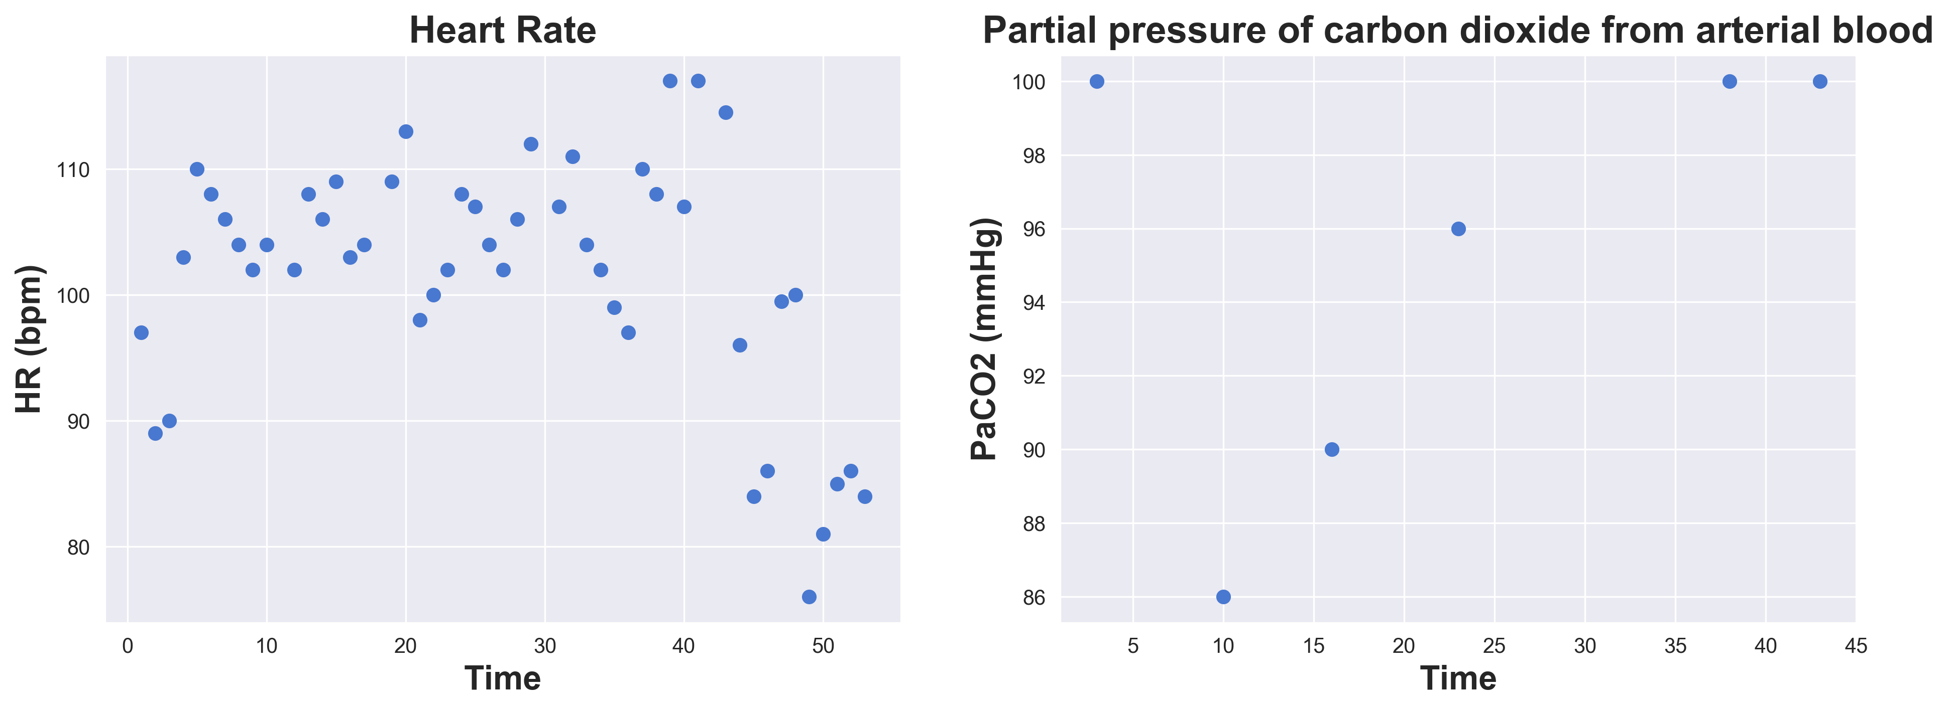
Example Data
Laboratory values are very sparsely filled

Slide 9
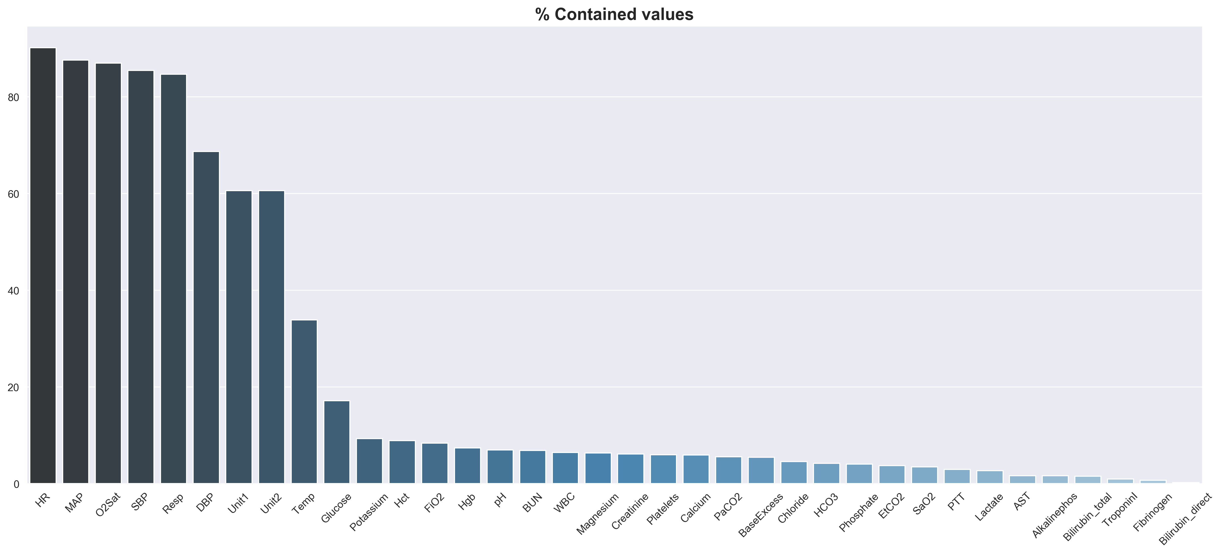
Missingness of Data

Slide 10
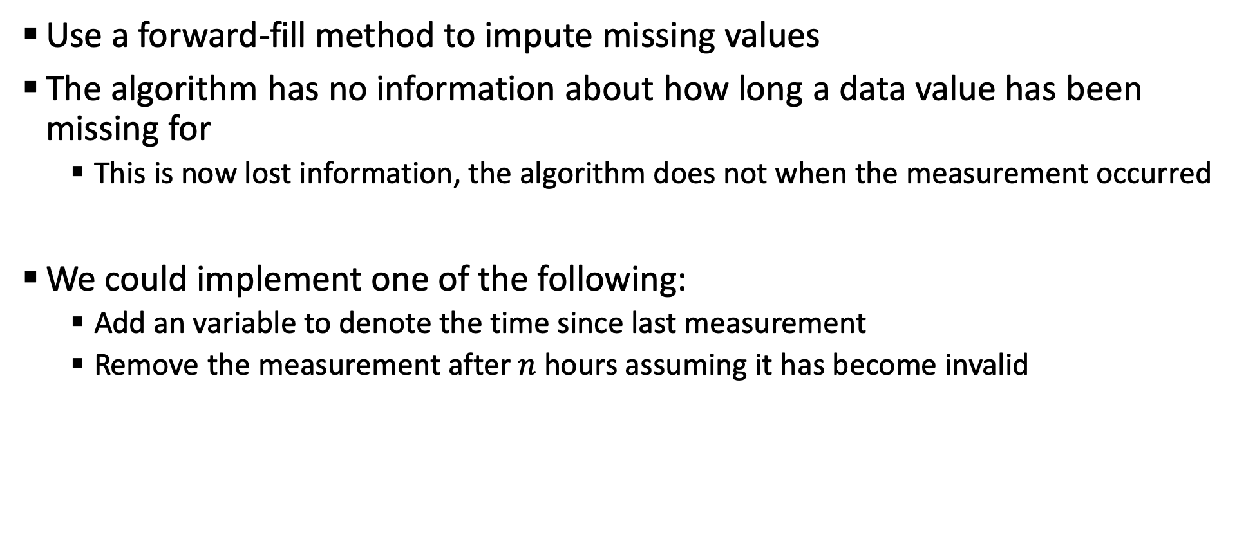
Missingness of Data
Use a forward-fill method to impute missing values
The algorithm has no information about how long a data value has been missing for
This is now lost information, the algorithm does not when the measurement occurred
We could implement one of the following:
Add an variable to denote the time since last measurement
Remove the measurement after $n$ hours assuming it has become invalid

Slide 11
Definition of Sepsis
Defined according to the new ‘Sepsis-3’ criteria.
Both of the following are required:
2 point deterioration of SOFA score in the last 24 hours.
Clinical suspicion of infection: Blood cultures drawn, administration of antibiotics.
Optimal prediction time is 6 hours before the above criteria is met.

Slide 12
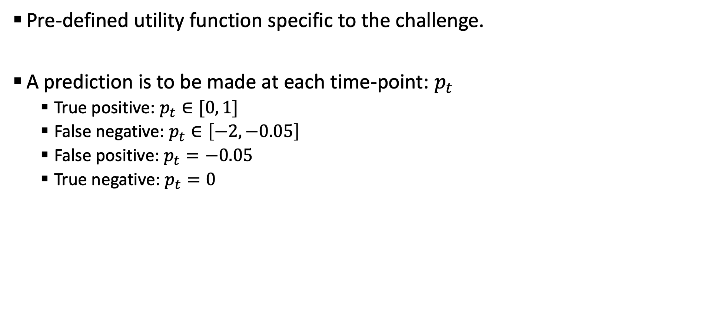
Scoring
Pre-defined utility function specific to the challenge.
A prediction is to be made at each time-point: $p_{t}$
True positive: $p_{t}∈[0, 1]$
False negative: $p_{t}∈\left[−2, −0.05\right]$
False positive: $p_{t}=−0.05$
True negative: $p_{t}=0$

Slide 13
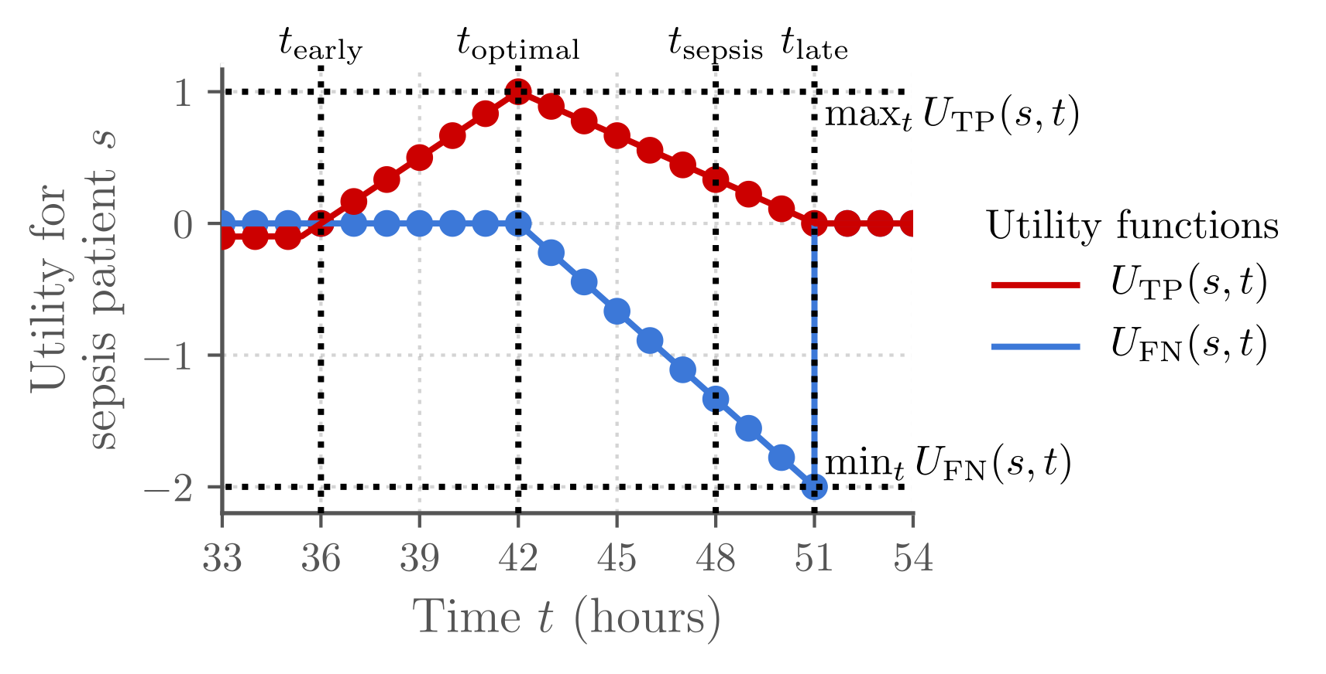
Scoring

Slide 14
Methodology: Relabeling
Scores are given according to the pre-defined utility function
Relabel the binary labels to account for the value of score one gets in prediction
Time | Utility Score |  | Final Label
 | 0 | 1
0 | 0.00 | -0.05 | -0.05
1 | -0.22 | 0.89 | 1.11
2 | -0.44 | 0.78 | 1.22
3 | -0.67 | 0.67 | 1.33
4 | -0.89 | 0.56 | 1.44

Slide 15
Additional Hand-Crafted Features
Feature Name | Description
ShockIndex | Ratio of heart rate to systolic blood pressure (HR/SBP)
BUN/CR | Bilirubin / creatinine ratio
PartialSOFA | Partial recreation of the SOFA score
SOFA Deterioration | Binary marker of deterioration
Min vitals | Min value each vital sign takes over some look-back window
Max vitals | Max value each vital sign takes over some look-back window
Num measurements | The number of measurements taken of each lab value over some lookback window

Slide 16
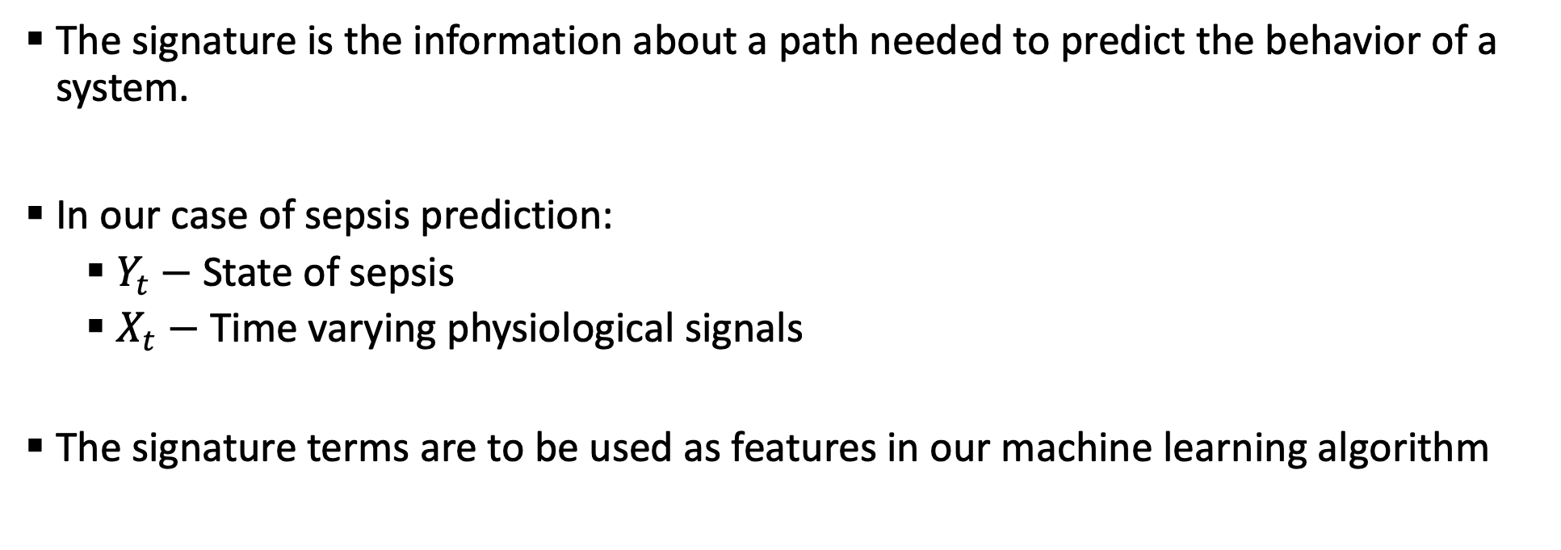
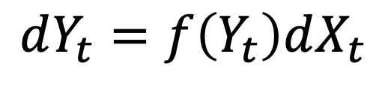
The Signature of a Path
An infinite sequence of numbers that completely characterizes a path
Used in the theory of controlled differential equations,
$$dY_{t}=f\left(Y_{t}\right)dX_{t}$$
The signature is the information about a path needed to predict the behavior of a system.
In our case of sepsis prediction:
$Y_{t}−$ State of sepsis
$X_{t}−$ Time varying physiological signals
The signature terms are to be used as features in our machine learning algorithm

Slide 17
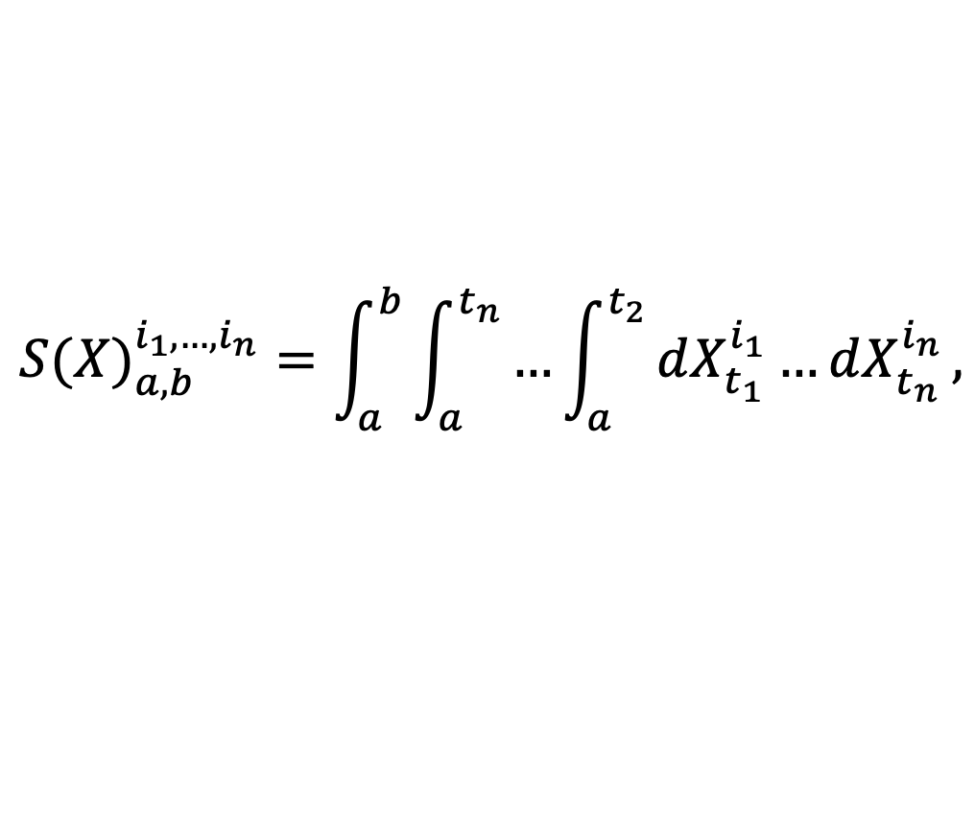
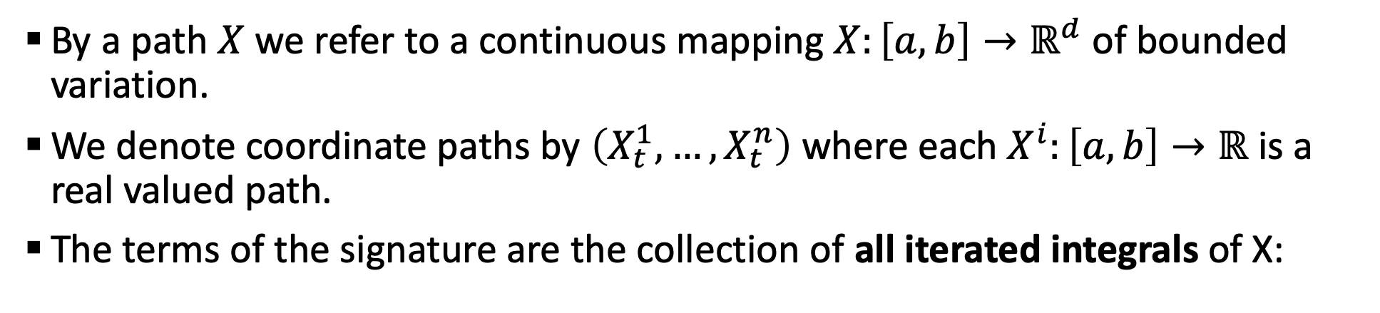
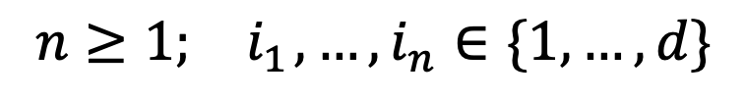
The Signature of a Path
By a path $X$ we refer to a continuous mapping $X:\left[a, b\right]→ℝ^{d}$ of bounded variation.
We denote coordinate paths by $\left(X_{t}^{1},…,X_{t}^{n}\right)$ where each $X^{i}:\left[a, b\right]→ℝ$ is a real valued path.
The terms of the signature are the collection of all iterated integrals of X:
$${S(X)}_{a,b}^{i_{1},…,i_{n}}=\int_{a}^{b}{\int_{a}^{t_{n}}{…\int_{a}^{t_{2}}{dX_{t_{1}}^{i_{1}}…dX_{t_{n}}^{i_{n}}},}}$$
$$n≥1;{ i}_{1},…,i_{n}∈\{1,…,d\}$$
We truncate to some order, these will be the features used in our machine learning algorithms

Slide 18
Extracting Time-Series Information
A sliding window approach is used to extract longitudinal information from the time-series
Window lengths are left as hyperparameters to be optimized

Slide 19
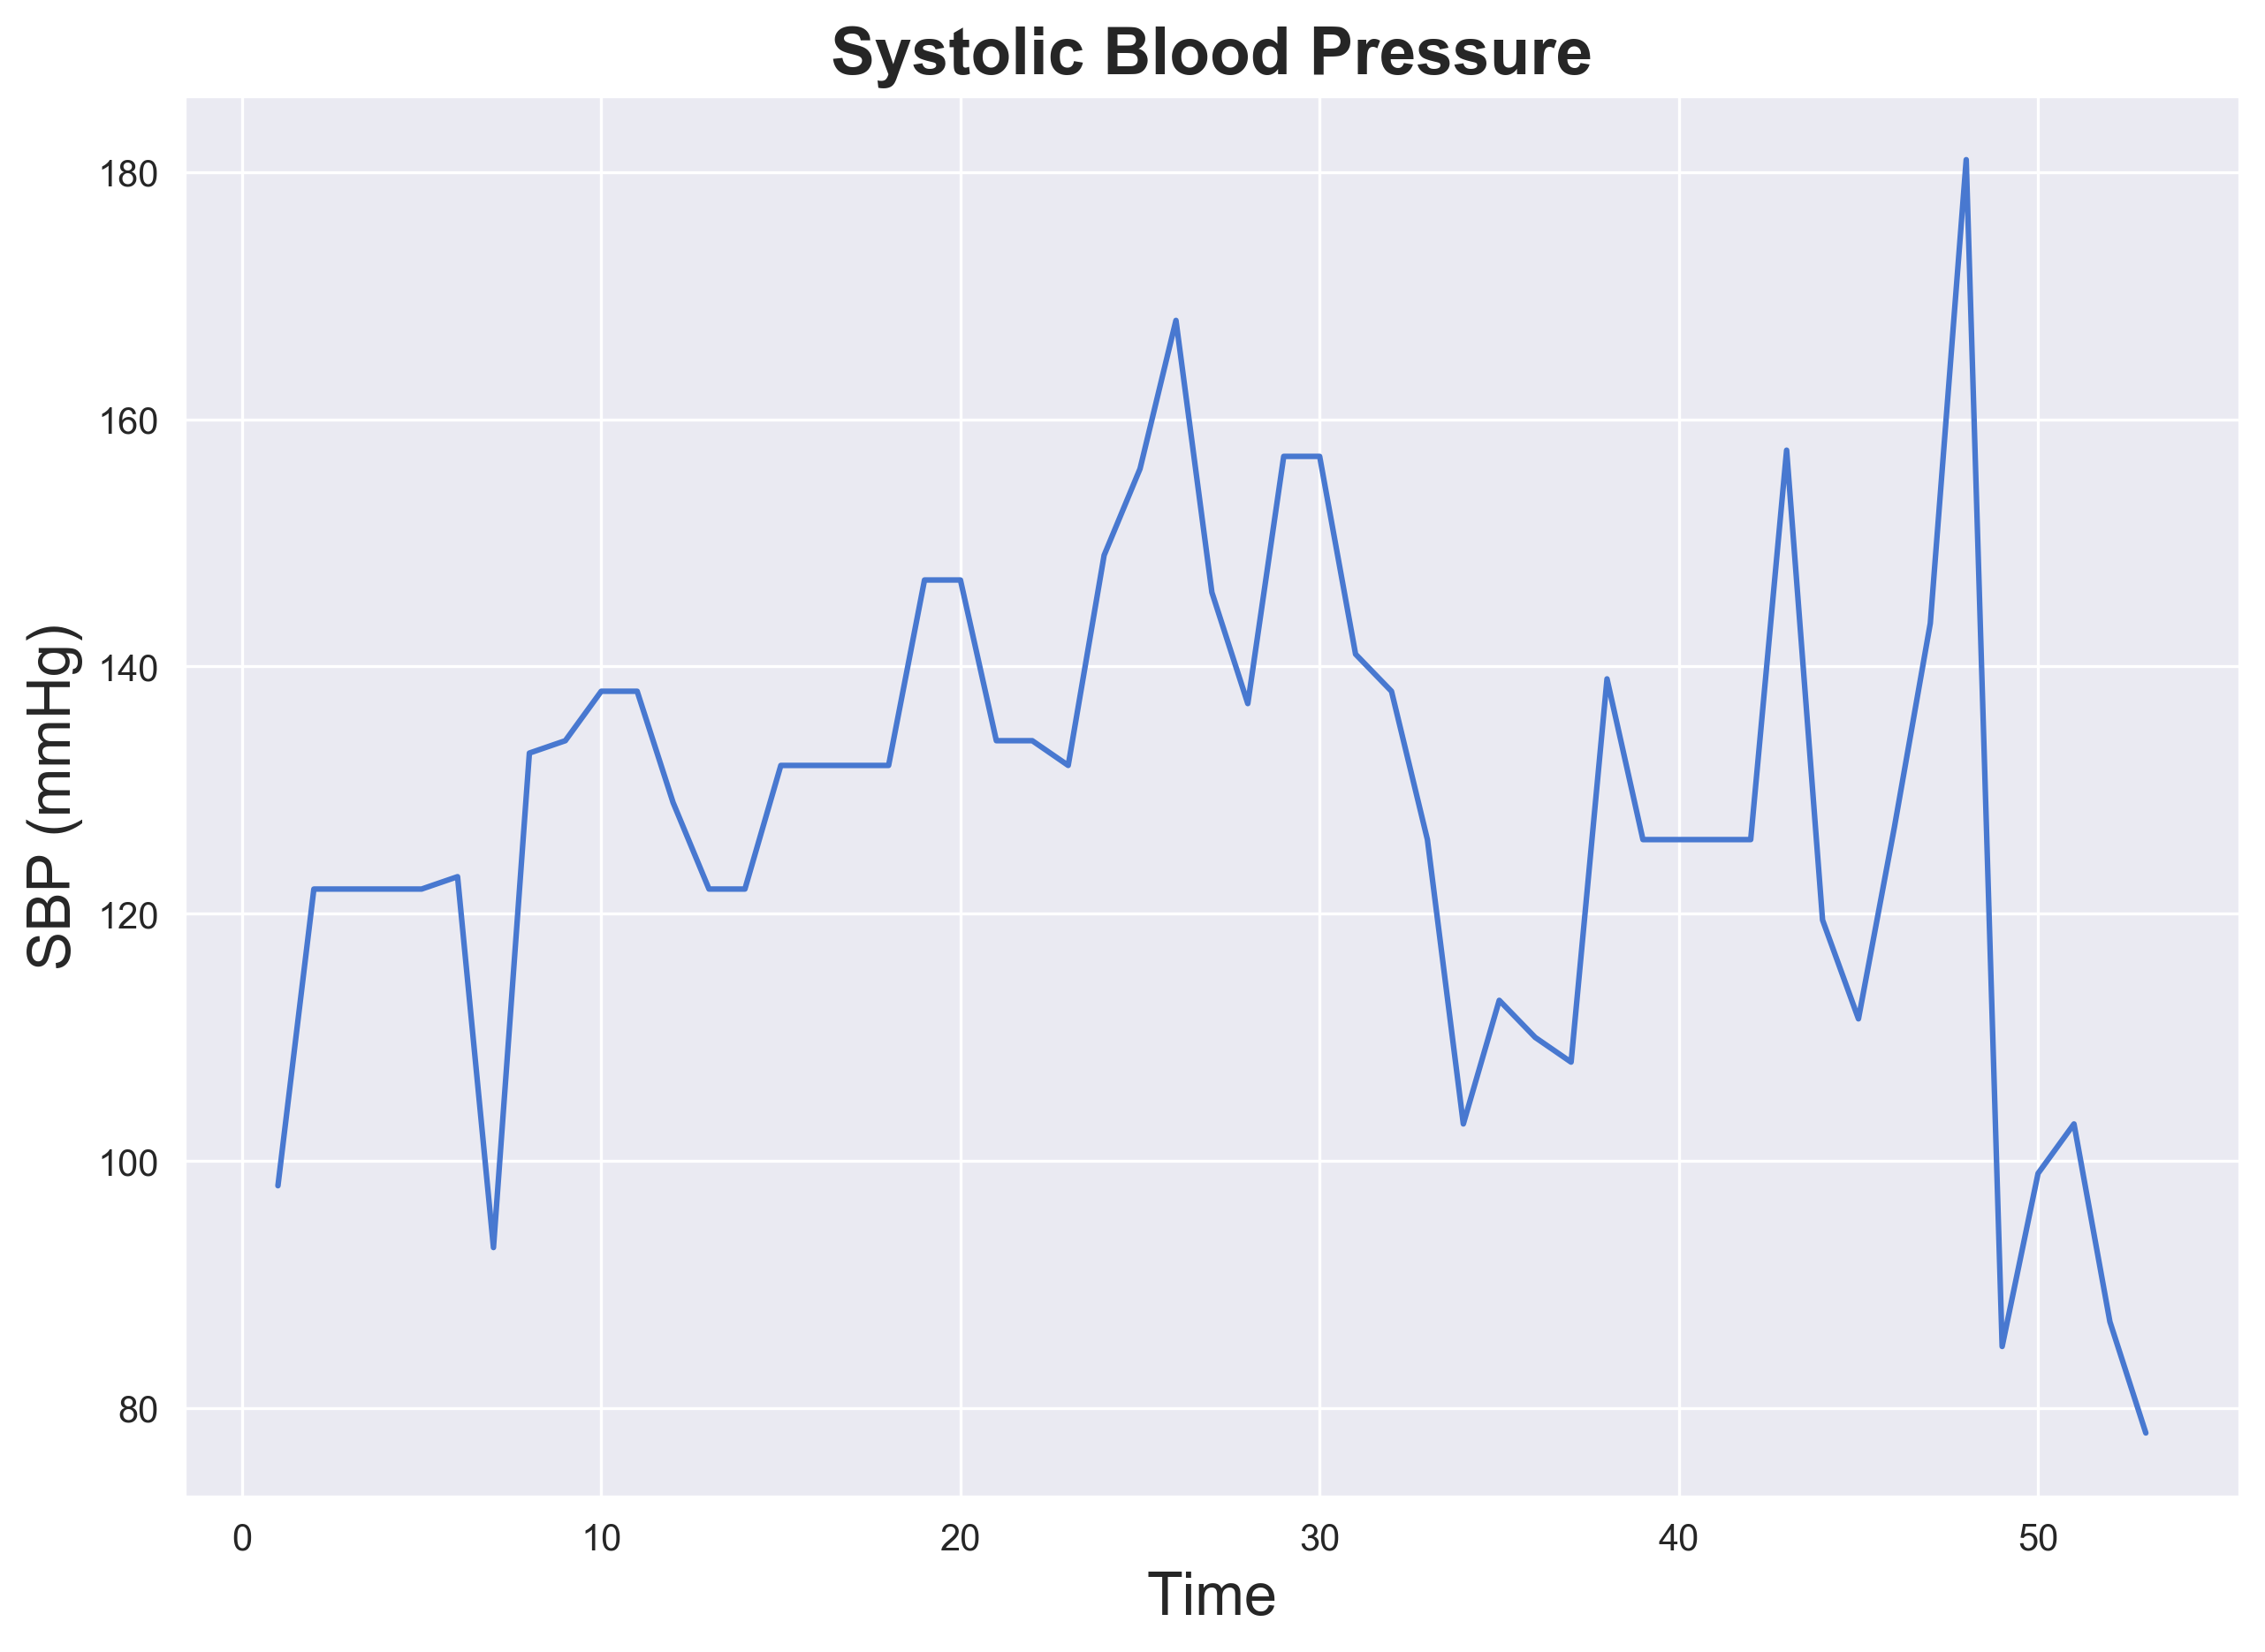
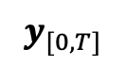
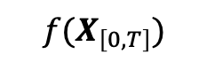
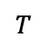
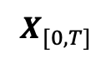
Extracting Time-Series Information
$$T$$
$$f(X_{\left[0, T\right]})$$
$$X_{[0, T]}$$
$$y_{[0, T]}$$

Slide 20
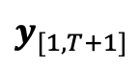
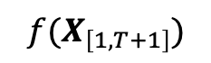
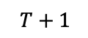
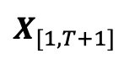
Extracting Time-Series Information
$$T+1$$
$$f(X_{\left[1, T+1\right]})$$
$$X_{[1, T+1]}$$
$$y_{[1, T+1]}$$

Slide 21
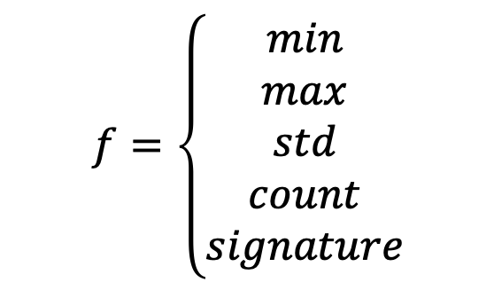
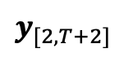
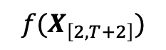
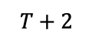
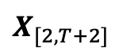
Extracting Time-Series Information
$$f=\left\{\begin{aligned}min \\ max \\ std \\ count \\ signature\end{aligned}\right.$$
This converts the path (potentially high-dimensional) onto a list of features
These features are a much better, and more succinct, representation of the information in the path than the path itself
$$T+2$$
$$f(X_{\left[2, T+2\right]})$$
$$X_{[2,T+2]}$$
$$y_{[2, T+2]}$$

Slide 22
Model Training process
Include initial 40 features
Optimized hyperparameters:
Features extracted
Look-back windows
Signature columns
Signature transformations
Signature orders
The choice of model is also optimized in the process, LGBM was found to be the best performer in nearly all cases
Augment with hand-crafted and signature features
Train an LGBM regressor using a 5-fold CV
Optimize hyperparameters
Optimize the regression threshold to determine 0 or 1 output to maximize the utility score on the training fold
Evaluate the model utility on the out-of-sample fold
Select and submit the model with the highest 5-fold averaged utility

Slide 23
Benefit of the Signature Terms
Features | Averaged Utility Score
Time only | 0.282

Slide 24
Benefit of the Signature Terms
Features | Averaged Utility Score
Time only | 0.282
Original 40 features only | 0.389

Slide 25
Benefit of the Signature Terms
Features | Averaged Utility Score
Time only | 0.282
Original 40 features only | 0.389
Hand-crafted features included | 0.418

Slide 26
Benefit of the Signature Terms
Features | Averaged Utility Score
Time only | 0.282
Original 40 features only | 0.389
Hand-crafted features included | 0.418
Hand-crafted features and signatures included | 0.430

Slide 27
Benefit of the Signature Terms
Features | Averaged Utility Score
Time only | 0.282
Original 40 features only | 0.389
Hand-crafted features included | 0.418
Hand-crafted features and signatures included | 0.430
The Signature uncovers information not found from more standard time-series feature extraction methods.

Slide 28
Official Challenge Results
‘Can I get your Signature?’ officially ranked 1st of 105 teams that took part in the official phase of the challenge

Slide 29
Official Challenge Results
Rank | Team Name | Utility Score
1 | Can I get your Signature? | 0.360
2 | Sepsyd | 0.345
3 | Separatrix | 0.339
4 | FlyingBubble | 0.337
5 | CTL-Team | 0.337
6 | SBU | 0.332
7 | Ping An Health Technology | 0.331
8 | prna | 0.328
9 | Antanas Kascenas | 0.323
10 | NN-MIH | 0.323

Slide 30
Generating Actionable Decisions
We wish to create clinically actionable information to physicians to help make decisions inside hospitals
Given the regression output, set a threshold that, once exceeded, will mark a patient ‘at risk’ of developing sepsis
This can be achieved with an AUC of 0.868

Slide 31
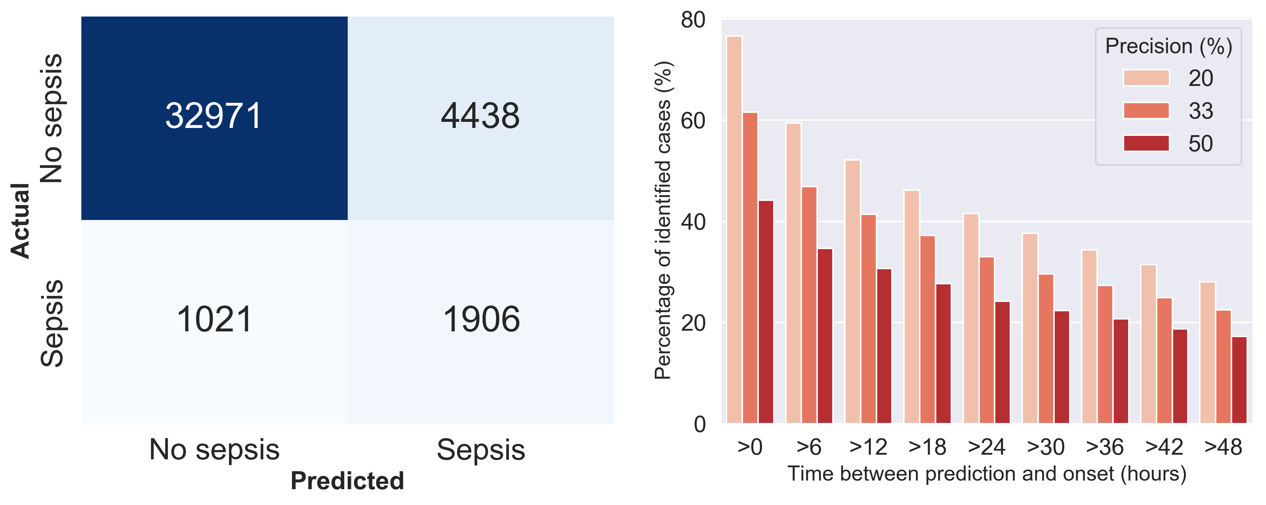
Generating Actionable Decisions
Notes:
The confusion matrix is at 33% specificity.

Slide 32
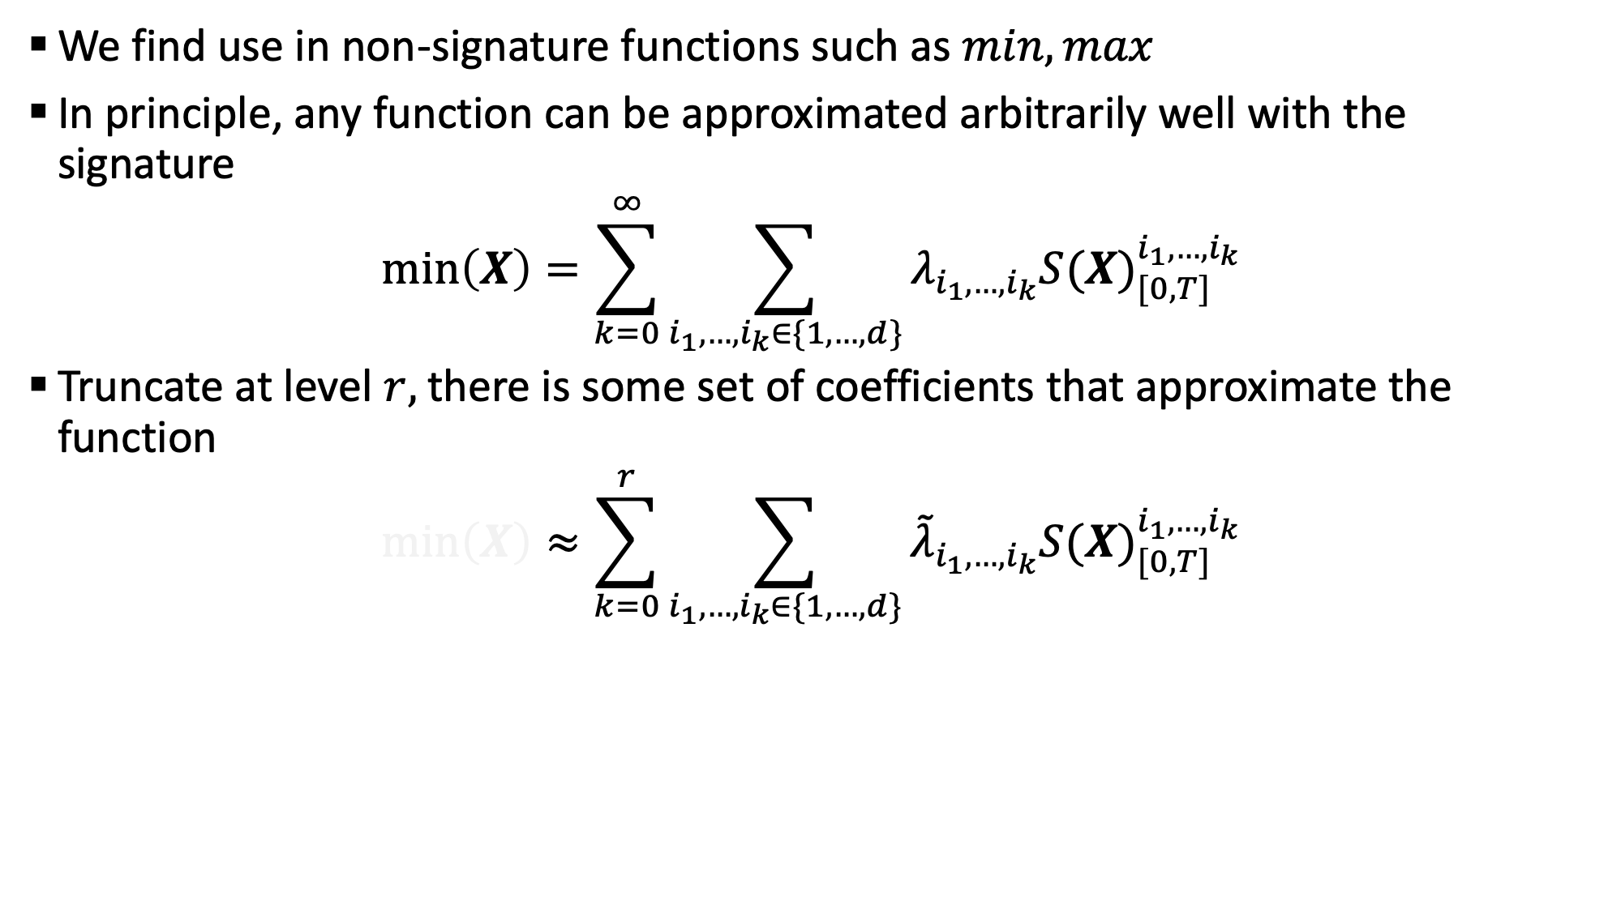
Expert Knowledge Must be Used when Available
We find use in non-signature functions such as $min, max$
In principle, any function can be approximated arbitrarily well with the signature
$$\min\left(X\right)=\sum_{k=0}^{∞}{\sum_{i_{1},…,i_{k}∈\{1,…,d\}}{λ_{i_{1},…,i_{k}}{S(X)}_{[0,T]}^{i_{1},…,i_{k}}}}$$
Truncate at level $r,$there is some set of coefficients that approximate the function
$$\min\left(X\right)≈\sum_{k=0}^{r}{\sum_{i_{1},…,i_{k}∈\{1,…,d\}}{{\tilde{λ}}_{i_{1},…,i_{k}}{S(X)}_{[0,T]}^{i_{1},…,i_{k}}}}$$

Slide 33
Expert Knowledge Must be Used when Available
More terms (higher truncation order) needed for high accuracy
Number of terms (and thus coefficients) increase exponentially with truncation level
This increases difficulty of the regression
With low levels of data, noise in coefficients is a problem
Generation of features with expert knowledge is necessary in cases with small data
Physicians who analyse the patient likely look at extreme values (min/max) over a time window
Extracting such a feature directly is better than relying on the signature in this case

Slide 34
Further Work
Train an LSTM and use the output as a feature in the LGBM Regressor
Add additional clinical variables:
Shock Index normalized by age
Give information about length of time a variable is missing
Weighted binary loss instead of regression
Optimize hyperparameters training on one hospital and validating on another

Slide 35
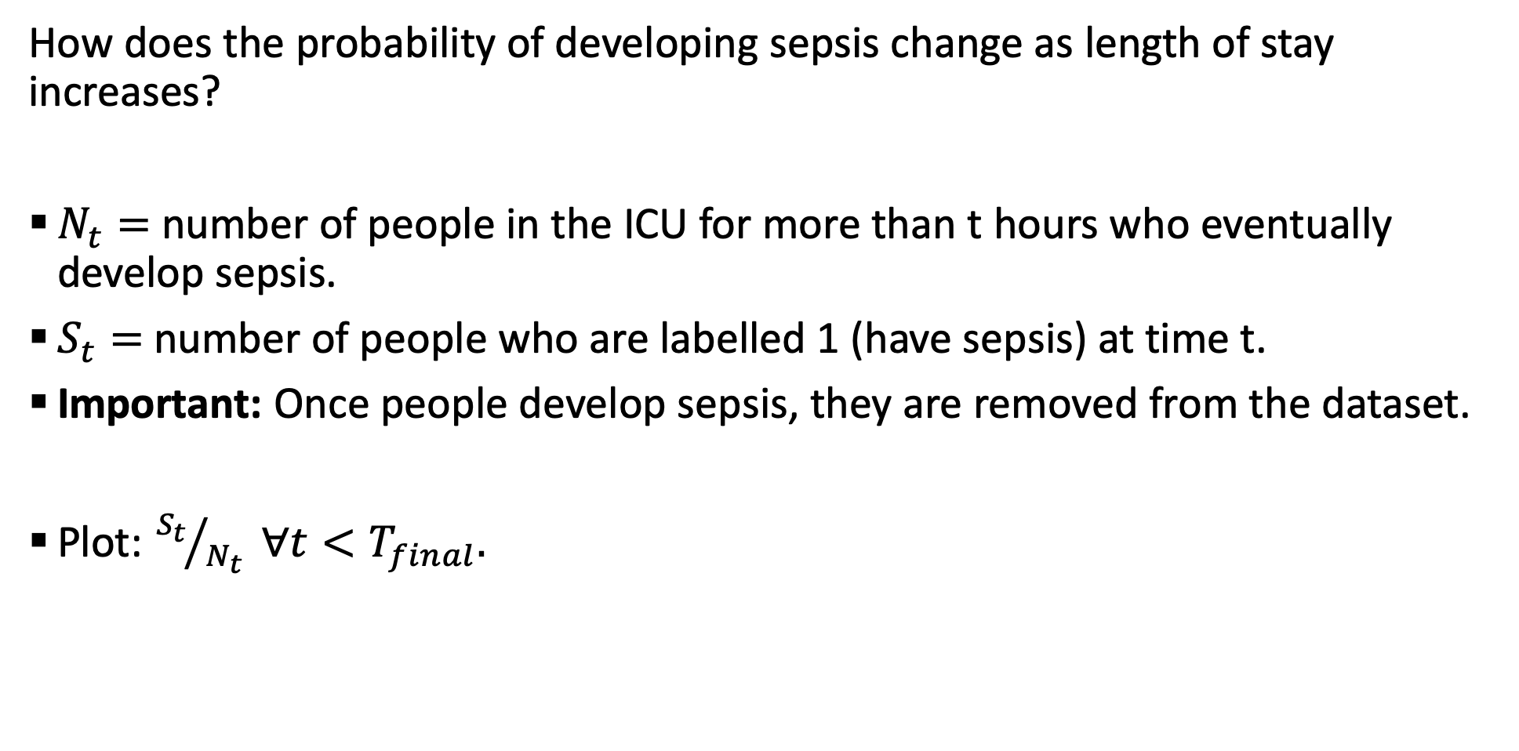
Occurrence of Sepsis is a Stationary Process
How does the probability of developing sepsis change as length of stay increases?
$N_{t}=$ number of people in the ICU for more than t hours who eventually develop sepsis.
$S_{t}=$number of people who are labelled 1 (have sepsis) at time t.
Important: Once people develop sepsis, they are removed from the dataset.
Plot: ${S_{t}}/{N_{t}} ∀t<T_{final}.$

Slide 36
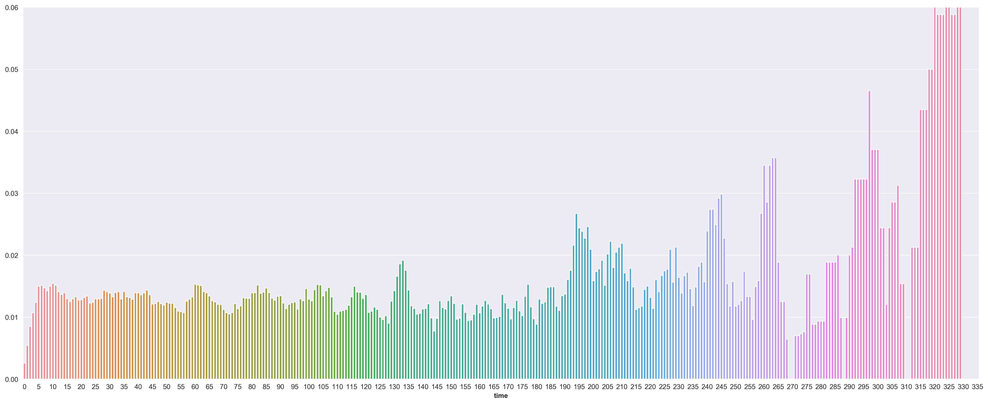
Occurrence of Sepsis is a Stationary Process

Slide 37
Plotting the Number With Sepsis from those that Develop
We consider only those who develop sepsis ‘eventually’
Plot the number of people from this group who have not yet developed it
If sepsis is stationary, we expect a constant rate of ‘uptake’
This would result in an exponential distribution

Slide 38
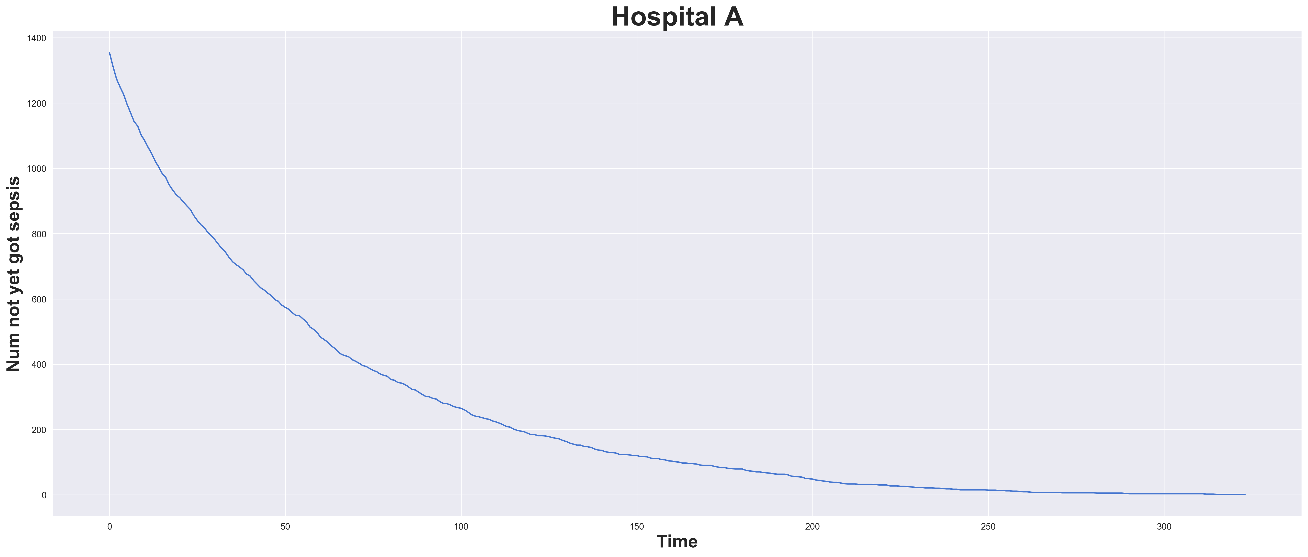
Sepsis Development in Hospital A

Slide 39
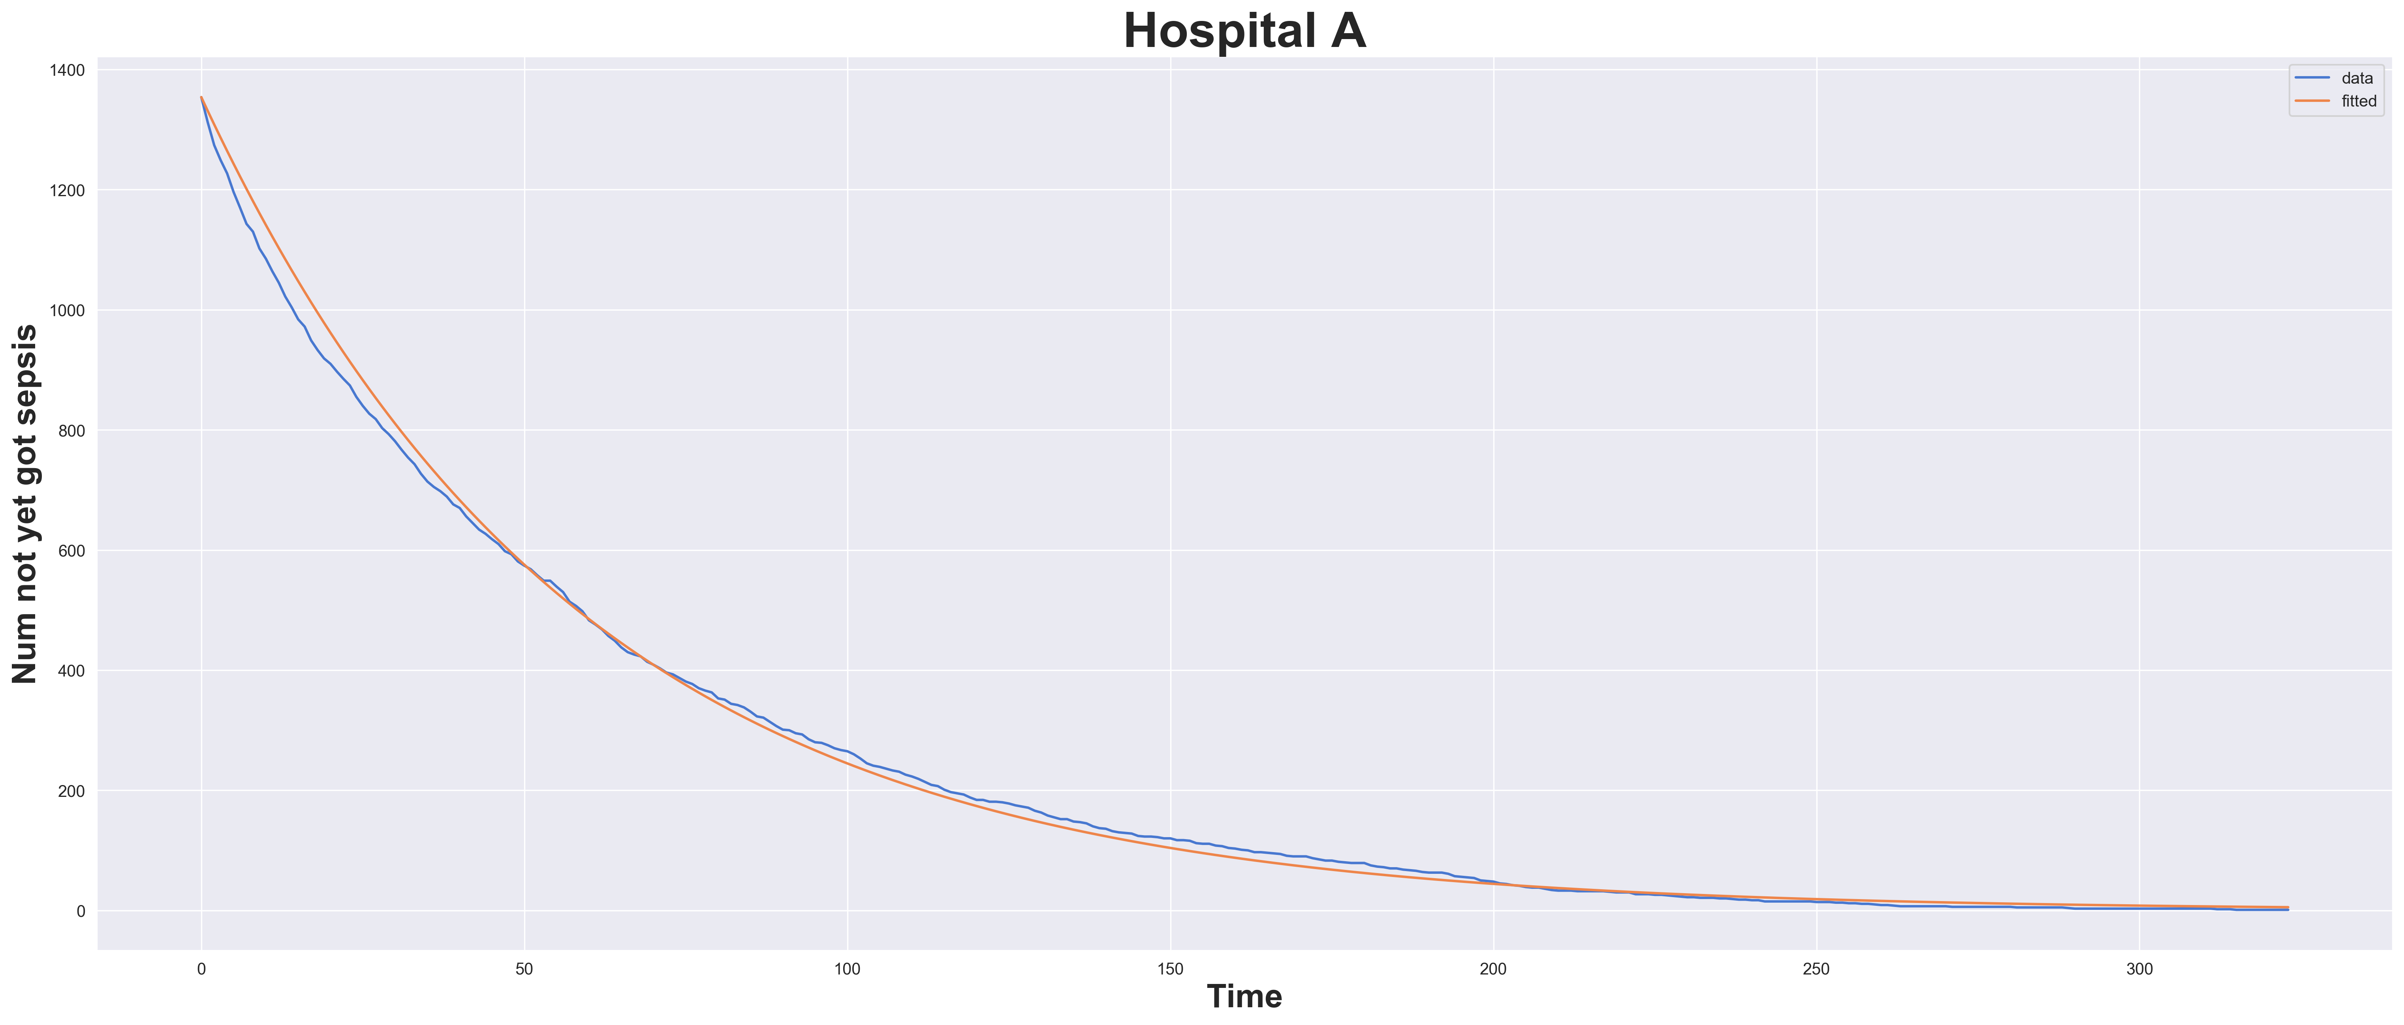
Exponential Fit to Hospital A Data

Slide 40
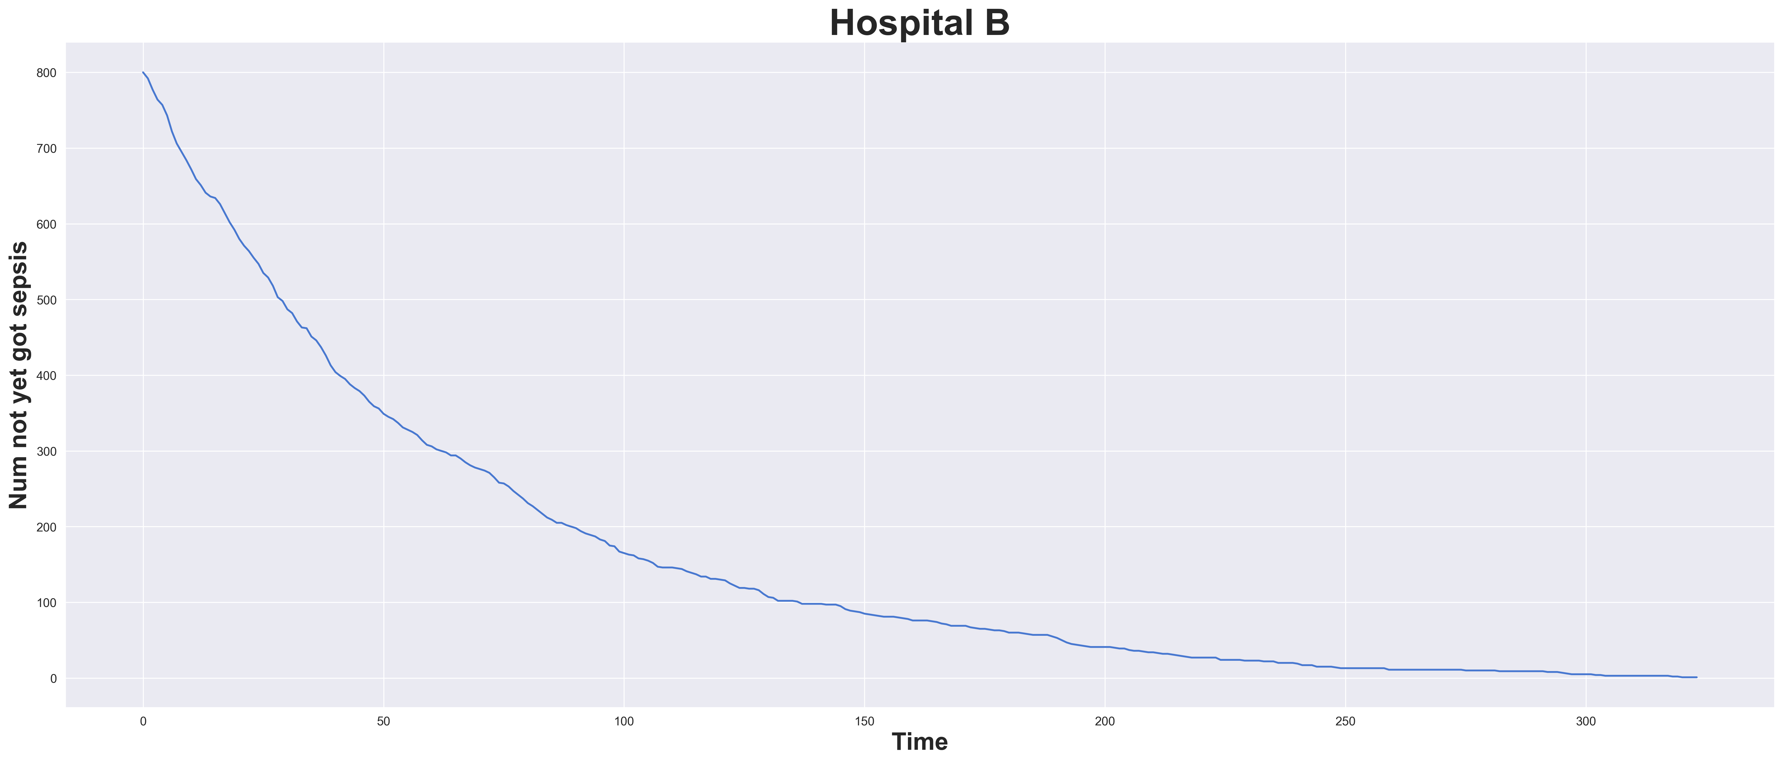
Sepsis Development in Hospital B

Slide 41
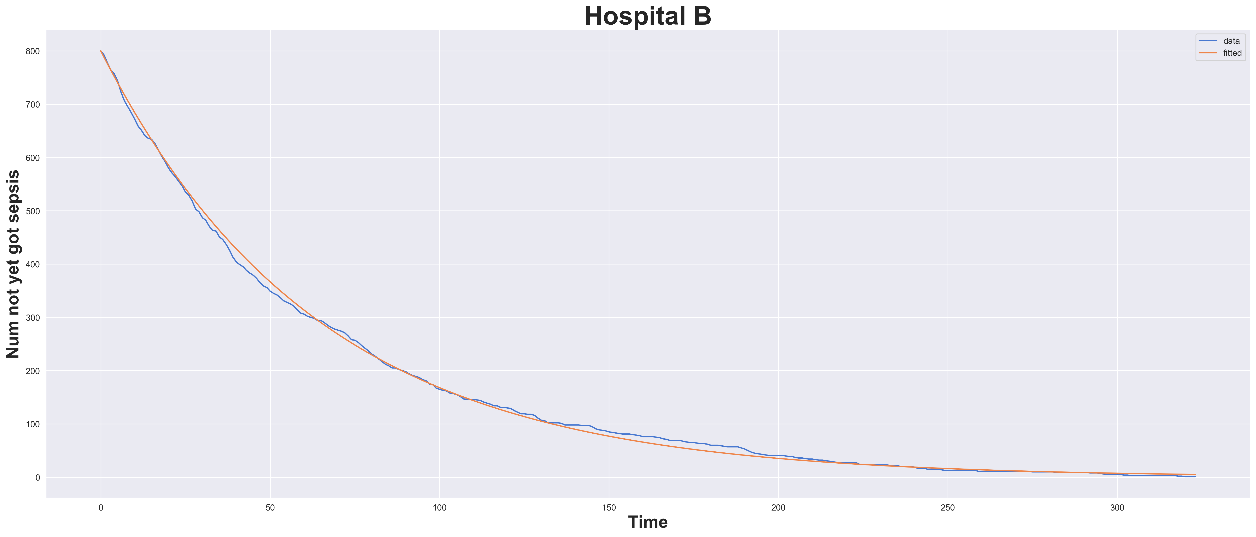
Exponential Fit to Hospital B Data

Slide 42
Sepsis Occurs Randomly
People enter the ICU, some of these are susceptible to sepsis
These people develop sepsis at an approximately constant rate
This rate will vary between hospitals
It may depend on cleanliness, hospital policy, patient demographics and so on

Slide 43
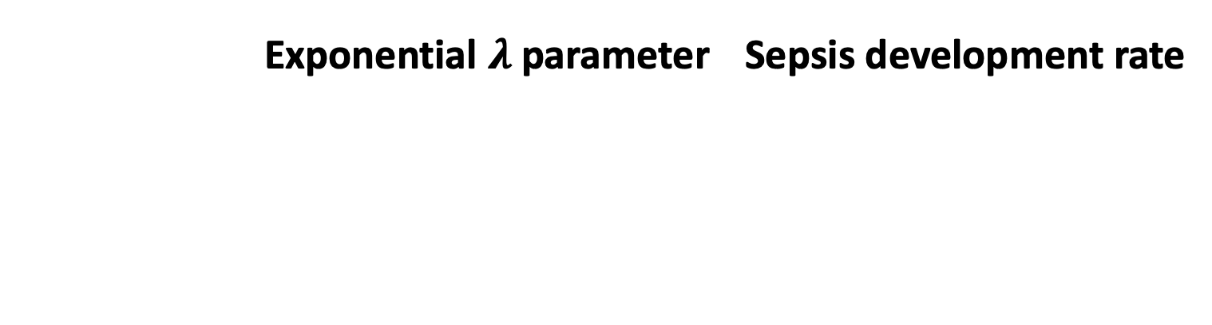
Fitted Parameters $⇒$ Rate of Sepsis
 | Exponential $λ$ parameter | Sepsis development rate

Slide 44
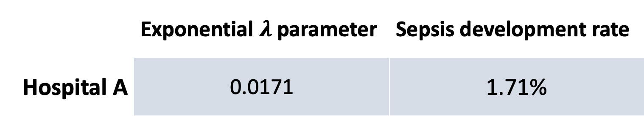
Fitted Parameters $⇒$ Rate of Sepsis
 | Exponential $λ$ parameter | Sepsis development rate
Hospital A | 0.0171 | 1.71%

Slide 45
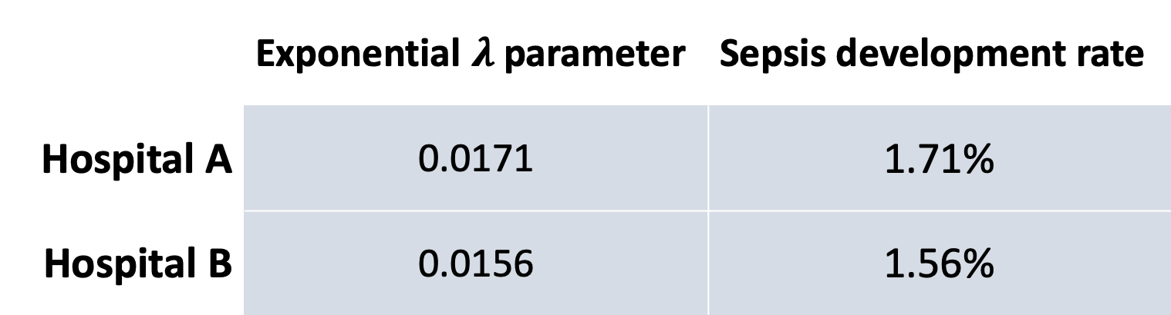
Fitted Parameters $⇒$ Rate of Sepsis
 | Exponential $λ$ parameter | Sepsis development rate
Hospital A | 0.0171 | 1.71%
Hospital B | 0.0156 | 1.56%

Slide 46
Predictions are Not Made in the 6 Hour Window

Slide 47
Predictions are Not Made in the 6 Hour Window
Optimal was defined as 6 hours before the occurrence of sepsis
Our model often detects sepsis much further in advance, regularly over 24 hours
This again suggests our hypothesis of susceptibility:
The model seems to be filtering out low risk cases
This is more of a risk-stratification model as opposed to one predicting sepsis occurrence
The usefulness of this should be determined by clinicians, a threshold can be set to achieve clinically meaningful sensitivity and specificity

Slide 48
Diagnosis is Important Information
If you are in for heart failure, it is likely that is all you are in for, and sepsis development becomes unlikely
Variables can indicate such conditions and thus help to separate out two groups
High FiO2 is likely with Heart failure for example
Specific diagnosis would be extremely useful information
Unfortunately, the diagnosis is usually not known at admission time
Cases where the diagnoses are known would be important to include

